Slide 1


ASP.NET MVC (3) View
小朱 (Azure MVP)
微軟開發技術玩家 / MCT / Freelance Trainer
MCSD: Azure Solution Architect / MCSD: Web Applications
K.NET Co-Founder

Slide 2
Agenda
上半場 (19:40-20:20)
View Concepts
Introduction to Bootstrap 3
Basic Razor
Master Page (Layout Page)
下半場 (20:30-21:10)
HTML Helpers
Customize HTML Helpers
Ajax

Slide 3
View
View 是用來負責呈現由 Controller 丟過來的資料，至於要怎麼呈現，是 View 的責任。
View means all response format of HTTP requests.
Text
HTML
XML
JSON
File Downloads
Decided by MIME type.

Slide 4
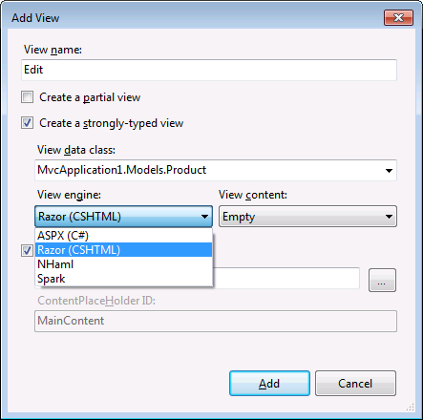
What To Choose?

Slide 5
Alternative View Engines
The following table describes and compares four popular view engines.
View Engine | Description
Razor | This is the default view engine for MVC 4. It is easy to learn for anyone who has experience in HTML and C# or Visual Basic.
ASPX | This was the default view engine for MVC 2. It is easy to learn for developers with experience in ASP.NET Web Forms and is also known as the Web Forms View Engine.
NHaml | NHaml is a .NET Framework version of the Haml view engine used with Ruby on Rails, a competitor to the ASP.NET MVC technology.
Spark | This view engine uses view files that are easily readable and similar to static HTML files.
Notes:
Also consider that, to create a custom view engine requires the developer to write sophisticated string-parsing code. For these reasons, this topic only introduces custom view engines and the reasons why developers occasionally create them.
Question: Is there any HTML markup that the Razor view engine cannot render?
Answer: No. Razor can render any HTML markup that you need, to display content to the user. However, for the reasons described in this topic, you may prefer another view engine.
20486A
05: Developing ASP.NET MVC 4 Views

Slide 6
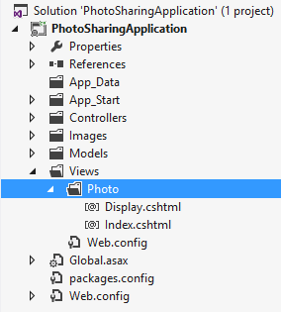
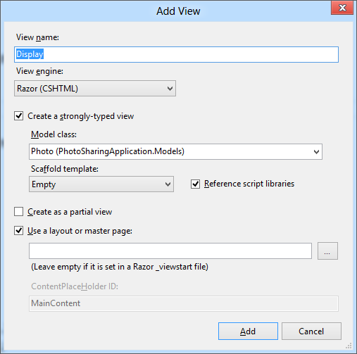
Adding Views
Notes:
Inform the students that they will learn more about layouts and master pages in Module 8 - Applying Styles to ASP.NET MVC 4 Web Applications.
Question: You are using the Razor view engine and Visual Basic to create views. You right-click the Delete action in the CustomerController.vb file. What is the name of the view file that Visual Studio will create by default?
Answer: The file name will be Delete.vbhtml unless you specify another name. It will be created in the Views/Customer folder.
20486A
05: Developing ASP.NET MVC 4 Views

Slide 7

前端技術像月亮，初一十五不一樣。

Slide 8
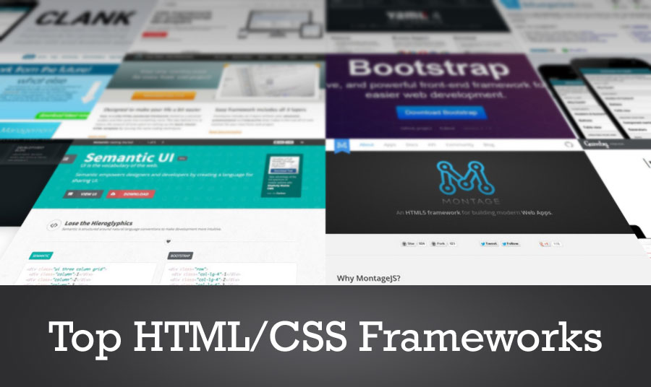
這麼多CSS Framework...

Slide 9

當然是選 Bootstrap!
較多人使用。
Visual Studio的範本用的是 Bootstrap。
NuGet 有套件。
神人的中文化 ☺
https://kkbruce.tw/bs3

Slide 10

Bootstrap

Slide 11
Differentiating Server Side Code from HTML
Razor identifies server-side code by looking for the @ symbol.
In Razor syntax, the @ symbol has various uses. You can:
Use @ to identify server-side C# code
Use @@ to render an @ symbol in an HTML page.
Use @: to explicitly declare a line of text as content and not code.
Use <text>to explicitly declare several lines of text as content and not code.
To render text without HTML encoding, you can use the Html.Raw() helper.
Notes:
Emphasize to the students that Razor is very sophisticated and it rarely misinterprets content and server-side code. Therefore, they will rarely use the @: and <text> delimiters.
Be very clear about the security implications of using Html.Raw() to disable HTML encoding. Emphasize that malicious users regularly test sites for weaknesses. If your use of Html.Raw() does enable script injection, a malicious user is very likely to notice and exploit the weakness.
20486A
05: Developing ASP.NET MVC 4 Views

Slide 12
Razor Basic

Slide 13
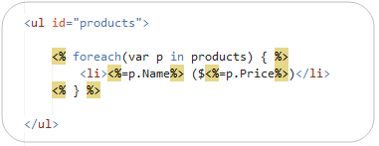
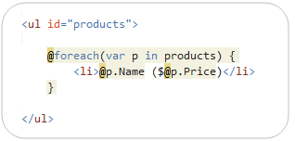
ASPX vs. Razor

Slide 14
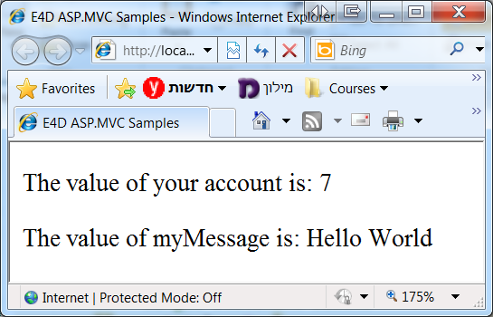
Single Statement Blocks
<!-- Single statement blocks -->
@{ var total = 7; }
@{ var myMessage = "Hello World"; }
<!-- Inline expressions -->
<p>The value of your account is: @total </p>
<p>The value of myMessage is: @myMessage</p>

Slide 15
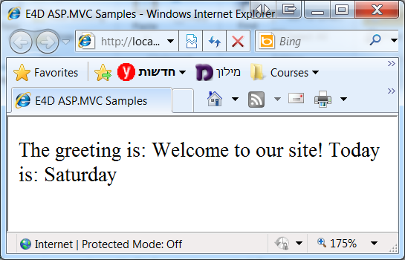
Multi-Statement Block
<!-- Multi-statement block -->
@{
var greeting = "Welcome to our site!";
var weekDay = DateTime.Now.DayOfWeek;
var greetingMessage = greeting + " Today is: " + weekDay;
}
<p>The greeting is: @greetingMessage</p>

Slide 16
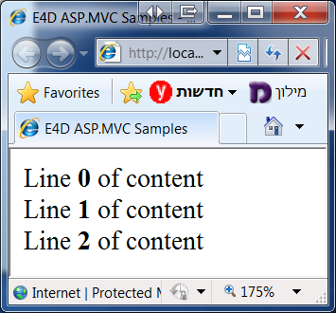
Lines of Content
@for( int i=0 ; i < 3 ; i++ )
{
@:Line <b>@i</b> of content <br/>
}
// Option II
@for( int i=0 ; i < 3 ; i++ )
{
<text>
Line <b>@i</b> of content <br/>
</text>
}

Slide 17
Code Comments
@* A one-line code comment. *@
@*
This is a multiline code comment.
It can continue for any number of lines.
*@
@{
@* This is a comment. *@
@* var theVar = 17; *@
}
@{
// This is a comment.
var myVar = 17;
/* This is a multi-line comment
that uses C# commenting syntax. */
}

Slide 18
Features of Razor Syntax
A sample code block displaying the features of Razor.
@* Some more Razor examples *@
<span>
Price including Sale Tax: @Model.Price * 1.2
</span>
<span>
Price including Sale Tax: @(Model.Price * 1.2)
</span>
@if (Model.Count > 5)
{
<ol>
@foreach(var item in Model)
{
<li>@item.Name</li>
}
</ol>
}
Notes:
Point out to the students that Razor easily differentiates content from code. For example, even within a Razor code block, when you add an HTML element such as <div>, Razor interprets the text as content. You do not usually need to use the @: delimiter to make this explicit.
Discuss the example code on the slide. Ensure that students understand the HTML that Razor will render.
Question: You want to describe a code block to developers in your view file. You do not want your description to be passed to the browser. What syntax should you use?
Answer: Declare the description as a Razor comment by enclosing it in @* *@ delimiters.
20486A
05: Developing ASP.NET MVC 4 Views

Slide 19
Binding Views to Model Classes and Displaying Properties
You can use strongly-typed views and include a declaration of the model class. Visual Studio helps you with additional IntelliSense feedback and error-checking as you write the code.
Binding to Enumerable Lists:
You can use dynamic views to create a view that can display more than one model class.
@model IEnumerable<MyWebSite.Models.Product>
<h1>Product Catalog</h1>
@foreach (var Product in Model)
{
<div>Name: @Product.Name</div>
}
Notes:
The code example in the slide shows how to use a strongly-typed view when the action controller passes a list of objects of a specific model class.
Question: You want to write a view that displays ten objects of the Photo model class. What model declaration should you use?
Answer: Use a declaration in the following form: @model IEnumerable<projectname/Models/Photo>
20486A
05: Developing ASP.NET MVC 4 Views

Slide 20
Strong-typed Model in Razor View

Slide 21
Master Page
<!DOCTYPE html>
<html>
<body>
<div id="Header">My Header</div>
<div id="main">
@RenderBody()
</div>
</body>
</html>
Master.cshtml
@{
Layout = "~/Views/Shared/E4D.cshtml";
ViewBag.Title = "Home Page";
}
<h2>@ViewBag.Message</h2>
<p>
@{
for( int i=0 ; i < 5 ; i++ ) {
<b>Hello World.</b><br/>
}
}
</p>
Index.cshtml

Slide 22
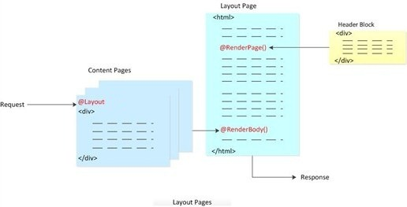
Master Page

Slide 23
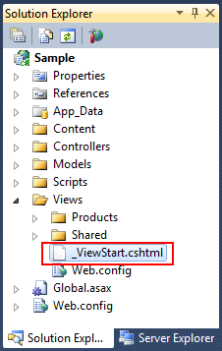
The _ViewStart File
Can be used to define common view code that you want to execute at the start of each View’s rendering.
@{
Layout = "~/Views/Shared/E4D.cshtml";
}
_ViewStart.cshtml

Slide 24
Layout Section
<html>
<head>ASP.NET MVC 3.0</head>
<body>
@RenderSection("Header")
@RenderBody()
@RenderSection("Footer", required: false)
</body>
</html>
E4D.cshtml
@{ Layout = "~/Views/Shared/_Layout.cshtml"; }
<html>
<head>ASP.NET MVC 3.0</head>
<body>
@section Header { <div>Header content</div> }
<div>Body Content</div>
@section Footer { <div>Footer content</div> }
</body>
</html>
Index.cshtml

Slide 25
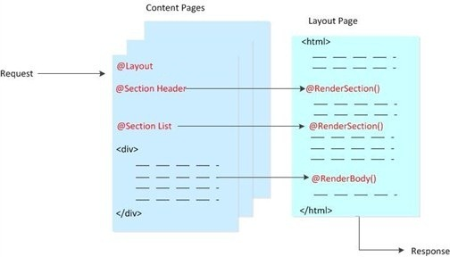
Master Page & Sections

Slide 26
IsSectionDefined method
The IsSectionDefined method returns true if a child content page defined a section.
<html> <body> @RenderBody() @if ( IsSectionDefined("OptionalContent") )
{ @RenderSection("OptionalContent") } else
{ <div>Default content</div> } </body> </html>
E4D.cshtml
Notes:
http://blogs.msdn.com/b/marcinon/archive/2010/12/08/optional-razor-sections-with-default-content.aspx
Just remember that you need to use the @RenderSection() syntax (you need the @ character) so that the contents of the section is actually printed to the output. Without that character you will get an exception with the following message:
The following sections have been defined but have not been rendered for the layout page "~/Views/Shared/_Layout.cshtml": "OptionalContent"

Slide 27
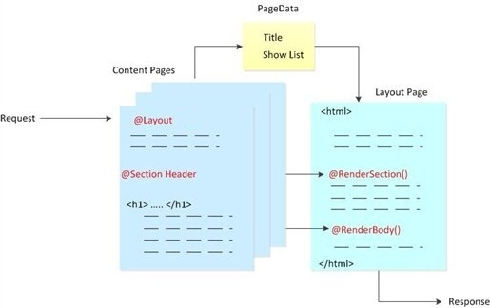
Passing Data to Layout Pages

Slide 28
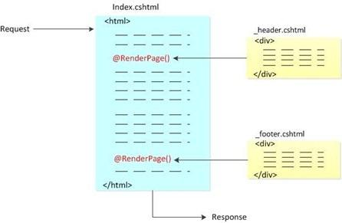
RenderPage

Slide 29
Master Page

Slide 30
Rendering Accessible HTML
You can ensure that your content is accessible to the broadest range of users by adhering to the following guidelines:
Provide alt attributes for visual and auditory content
Do not rely on color to highlight content
Separate content from structure and presentation code:
Only use tables to present tabular content
Avoid nested tables
Use <div> elements and positional style sheets to lay out elements on the page
Avoid using images that include important text
Put all important text in HTML elements or ALT attributes
Notes:
Question: You want to present your company logo at the top of the page. The logo is a .gif file that includes the name of the company in an unusual font. How can you ensure that the logo is accessible?
Answer: Text readers will not be able to read company name from inside the logo file. Because the font is unusual, you cannot render it by styling text markup. However, you can add an alt attribute to the <img> tag and use it to describe the logo to the blind or to users with low vision. Users with clear sight can see the text in the image.
20486A
05: Developing ASP.NET MVC 4 Views

Slide 31
Creating Partial Views
You can use partial views to render the same HTML content in different locations in your web application
Creating and Naming Partial Views:
Create a partial view by using the Add View dialog
Name partial views with an underscore prefix to keep to convention
Strongly-typed and dynamic partial views:
Create strongly-typed partial views if you are certain that the partial view will always display the same model class.
Create dynamic partial views if you are not sure if the partial view will always display the same model class.
Notes:
In this topic, the contents of partial views, which do not render complete webpages, are contrasted with the contents of other views, which include <body> and <head> tags for a complete webpage. If you use template views, <body> and <head> tags appear in the template, and not in the view file. In such web applications the content of views and partial views can appear similar. However, students do not learn about template views until Module 8- Applying Styles to ASP.NET MVC 4 Web Applications. Do not introduce template views in this module because this might confuse students.
Question: You want to create a partial view that displays a list of comments. The comments partial view will be called by actions in the PhotoController and the HomeController. In which folder should you create the partial view file?
Answer: You should create the partial view in the /Views/Shared folder so that multiple controllers can access it.
20486A
05: Developing ASP.NET MVC 4 Views

Slide 32
Using Partial Views
Using HTML helpers, you can use partial views within other views in a web application:
To pass the same model object to a partial view from the parent view, use Html.Partial()
To pass a model object to a partial view, which is different from the parent view or of a different model class, use Html.Action()
Use the ViewBag and ViewData collections to share data between the controller action, parent view, and partial view
Notes:
Question: You want to display user reviews of a product to each product page. You have created a _ReviewsForProduct partial view. Would you use Html.Partial() or Html.Action() to render this view?
Answer: You would use Html.Action() to render this view so that you can pass a different model object, in this case, a collection of reviews, to the partial view.
20486A
05: Developing ASP.NET MVC 4 Views

Slide 33
@Html.Partial()
E4D.cshtml
<html> <body>
@Html.Partial("PartialIndex"); @RenderBody() </body> </html>

Slide 34
Use Razor Inline Templates
public static class SectionExtensions
{
private static readonly object _o = new object();
public static HelperResult RenderSection( this WebPageBase page, string sectionName,
Func<object, HelperResult> defaultContent)
{
if (page.IsSectionDefined(sectionName))
return page.RenderSection(sectionName);
else
return defaultContent(_o);
}
}
<body>
...
@this.RenderSection( "Footer", @<div>Default content</div>)
</body>

Slide 35
Partial Views

Slide 36
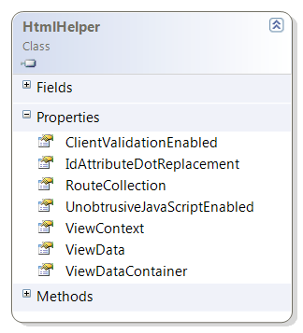
HtmlHelper Class
Helper methods and extensions are called using the Html property of the view, which is an instance of the HtmlHelper class.
Extension methods for the HtmlHelper class are in the System.Web.Mvc.Html namespace.
@Html.CheckBox("Test it");
Notes:
http://msdn.microsoft.com/en-us/library/system.web.mvc.htmlhelper.aspx

Slide 37
Basic HTML Helpers
ActionLink
BeginForm
CheckBox
DropDownList
Hidden
ListBox
Password
RadioButton
TextArea
TextBox
Notes:
http://msdn.microsoft.com/en-us/library/dd410596%28v=vs.98%29.aspx

Slide 38
Using Action Helpers
Html.ActionLink()
Url.Action()
@Html.ActionLink("Click here to view photo 1", "Display", new { id = 1 })
<a href="/photo/display/1">
Click here to view photo 1
</a>
<img alt="This image came from an action" src="@Url.Action("GetImage", new { id = 1 })" />
<img alt="This image came from an action" src="/photo/getimage/1" })"
/>
Notes:
The action helpers described in this topic examine the routes defined in your web application to render the correct URLs. Students have not yet learned about the routing engine or how to modify routes. They will learn about routing in Module 7.
Question: You want to render an HTML5 <audio> tag to play a sound file from an action. Would you use the Html.ActionLink() helper or the Url.Action() helper?
Answer: You would use the Url.Action() helper because you are rendering an attribute within the <audio> tag, and not a complete <a> element.
20486A
05: Developing ASP.NET MVC 4 Views

Slide 39
Using Display Helpers
Html.DisplayNameFor()
Html.DisplayFor()
@Html.DisplayNameFor(model => model.CreatedDate)
Created Date
@Html.DisplayFor(model => model.CreatedDate)
03/12/2012
Notes:
Question: You want to ensure that a view displays “This product was last changed on” before the ModifiedDate property. This text is declared in the class with the DisplayName annotation. What code would you write in the view?
Answer: @Html.DisplayNameFor(model => model.ModifiedDate)
20486A
05: Developing ASP.NET MVC 4 Views

Slide 40
The Begin Form Helper
Html.BeginForm()
@using (Html.BeginForm("Create", "Photo", FormMethod.Post, new { enctype = "multipart/form-data" }))
{
@* Place input controls here *@
}
<form action="/Photo/Create" method="post“
enctype="multipart/form-data">
</form>
Notes:
Question: You have created a form with a file selector control that uses the GET method. You have set the enctype attribute to multipart/form-data but when you try to access the file in the action method, an exception is thrown. What have you possibly done incorrectly?
Answer: You must use the POST method to upload files.
20486A
05: Developing ASP.NET MVC 4 Views

Slide 41
Using Editor Helpers
Html.LabelFor()
Html.DisplayFor()
@Html.LabelFor(model => model.ContactMe)
<label for="ContactMe"> Contact Me </label>
@Html.EditorFor(model => model.ContactMe)
<input type="checkbox" name="Description">
Notes:
Question: You have a property in the Product model class named ProductID. You want to include this in the HTML page so that client-side script can use the ProductID value. However, you do not want the value to be displayed to users. In the model class, you have annotated the ProductID property with the [HiddenInput(DisplayValue=false)] attribute. How will the Html.EditorFor() helper render this property?
Answer: The Html.EditorFor() helper renders the following HTML:
<input name="ProductID" type="hidden" value="id">
20486A
05: Developing ASP.NET MVC 4 Views

Slide 42
Using Validation Helpers
Html.ValidationSummary()
Html.ValidationMessageFor ()
@Html.ValidationSummary()
<ul>
<li>Please enter your last name</li> <li>Please enter a valid email address</li> </ul>
@Html.ValidationMessageFor(model => model.Email)
Please enter a valid email address
Notes:
Remind the students that they learned how to set validation requirements in model classes by using validation data annotations such as [Required] in Module 3. They have also learned how to check the validity of user data in a controller action by testing the ModelState.IsValid property in Module 4.
20486A
05: Developing ASP.NET MVC 4 Views

Slide 43
HTML Helpers

Slide 44
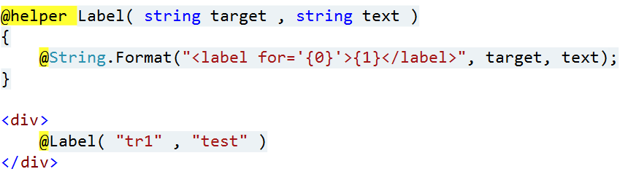
@helper Syntax

Slide 45
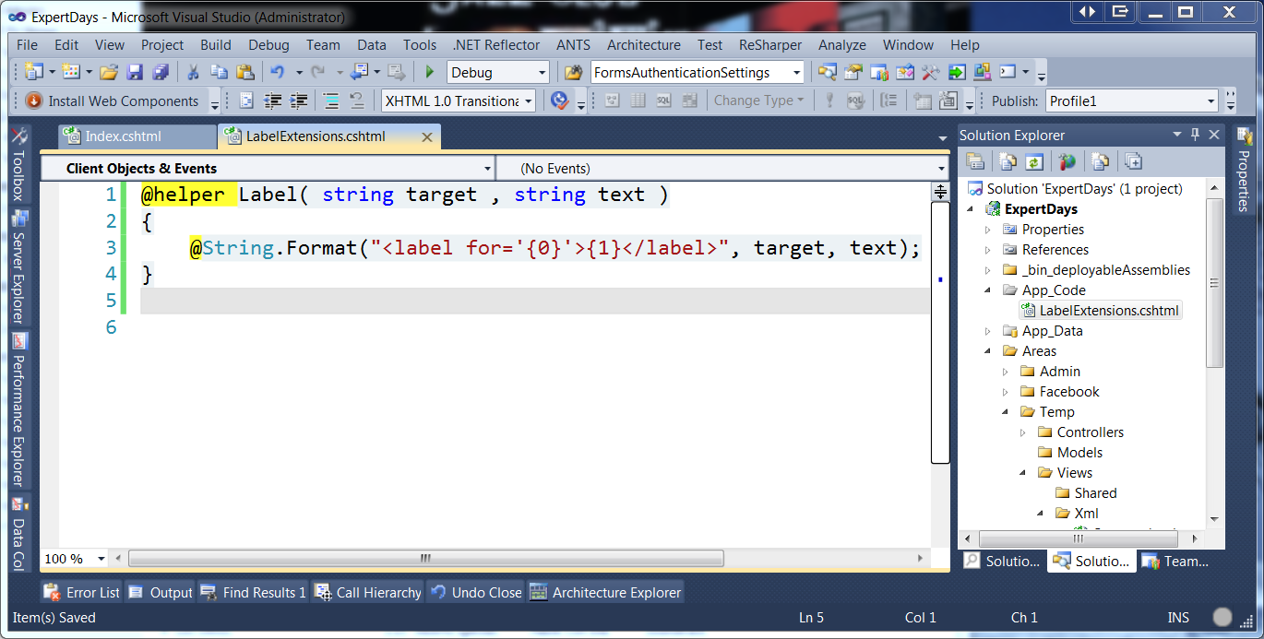
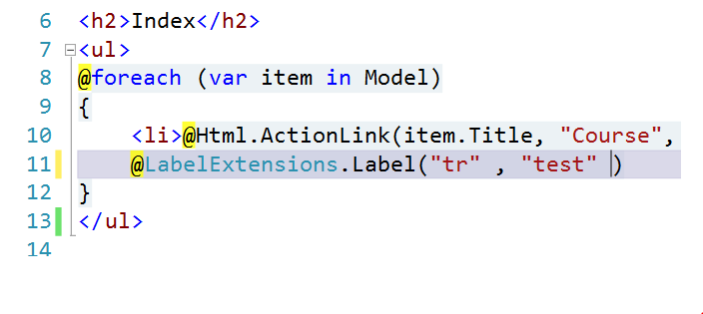
@helpers Across Multiple Views

Slide 46
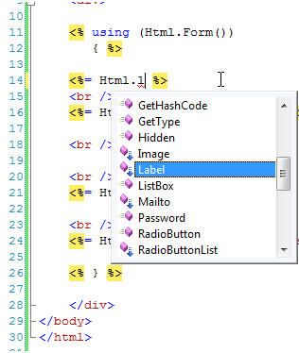
Custom HTML Helper
public static class LabelExtensions { public static string Label( this HtmlHelper helper, string target, string text) { return String .Format("<label for='{0}'>{1}</label>", target, text); } }

Slide 47
TagBuilder Class
Represents a class that is used by HTML helpers to build HTML elements.
public static class ImageHelper { public static MvcHtmlString Image(this HtmlHelper helper, string id, string url, string alt) { var builder = new TagBuilder("img"); builder.GenerateId(id); // Add attributes builder.MergeAttribute("src", url); builder.MergeAttribute("alt", alt); return new MvcHtmlString( builder.ToString(TagRenderMode.SelfClosing) ); } }
Notes:
http://msdn.microsoft.com/en-us/library/system.web.mvc.tagbuilder.aspx
http://www.asp.net/mvc/tutorials/using-the-tagbuilder-class-to-build-html-helpers-cs

Slide 48
Razor Helpers and HTML Helpers

Slide 49
Ajax
酷炫的標配☺。
Ajax 機制已經不像以前那麼難做，但也不是可以完全忽略它的標準流程。
Server: Content Provider (Controller Action or API).
Client: JavaScript Action Invoker.
可能還要考慮到 CORS (Cross-Origin Resource Sharing) 的問題。
MVC 不是沒有Ajax的支援，但它真的沒有很方便...

Slide 50
Ajax in ASP.NET MVC

Slide 51
References
http://bootsnipp.com
https://kkbruce.tw/bs3
ASP.NET MVC View UI, Layouts and Themes : http://www.asp.net/web-pages/overview/ui,-layouts,-and-themes
Tag Builder: http://demo.tc/post/564

Slide 52

學習 MVC，你可以選擇…
由 5 位 MVP 合作執筆。
其中三位是 twMVC 社群成員，二位創始人。
台灣最暢銷的 ASP.NET MVC 中文書。
針對 Model, LINQ, EF, View 等重要議題完整涉獵。
範例程式置於 Github 可隨意下載取用。

Slide 53

K.NET: 高雄在地的 .NET 社群
每週三聚會
星巴克裕誠店 (近捷運巨蛋站) 或彩色巴黎，依粉絲團公告為準。
想請教，想閒聊都行 ☺
七月起每月舉辦1-2場研討會。
想聽什麼樣的議題，可以在粉絲團或是週三聚會時提出喔。
非免費 ☺
Welcome to join us! http://on.fb.me/1b4UPZS

Slide 54
//Build Mini// 2015
K.NET 主辦的首場研討會。
由 Build 2015 與 Ignite 2015 的熱門議題中取材。
ASP.NET 5 & MVC 6 & Azure App Services.
Windows 10 Universal Application Platform, Visual Studio 2015, Visual Studio Code and Cordova App.
日期：6/6 13:30-17:30
地點：青年職涯發展中心
新技術讓你一次獲得。
Register Now!
http://knet.kktix.cc/events/build-mini

Slide 55
Thank you!

